Slide 1

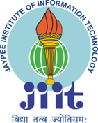
JAYPEE INSTITUTE OF INFORMATION
TECHNOLOGY, NOIDA , SECTOR-62
LIFE SKILL PROJECT
IS INDIA READY FOR CASHLESS economy ??
SUBMITTED TO: BY:
Mrs. Ankita Das Ma’am
1)HIMANSHU DIXIT (21103262)
2)AASHUTOSH PRADHAN (21103242)
3)ARYAMAN VISHNOI (21103260)
4)ARYAN RAZDAN (21103271)

Slide 2

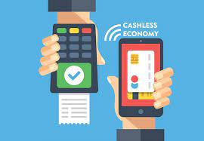
CONTENT
Introduction
Why cashless?
Advantages of online payment
Benefits of cashless society
Digital payment modes
Data figures
Disadvantages
Conclusion
References

Slide 3
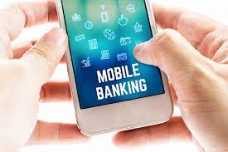
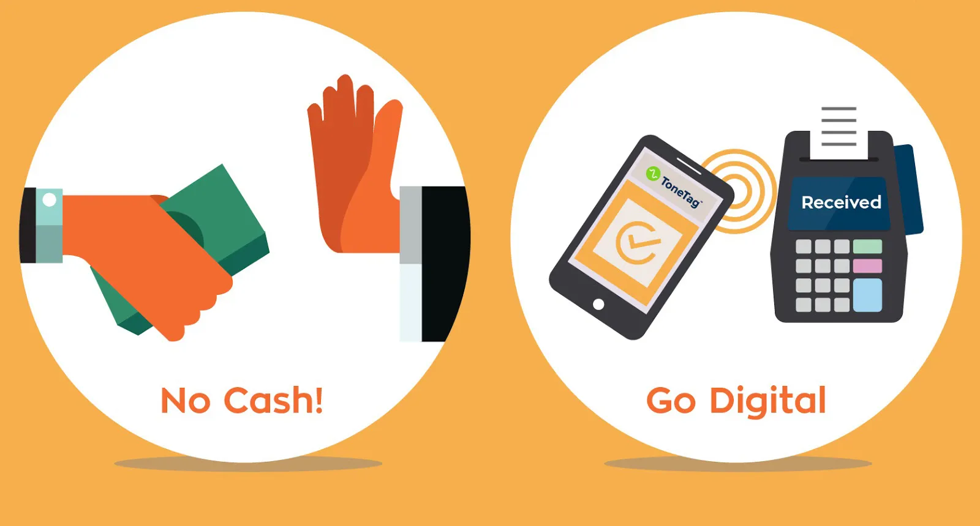
CASHLESS ECONOMY
A cashless economy is one in which all the
Transactions are done using cards or digital
means.The circulation of physical currency is
minimal..
The money transactions are done through
means like debit card, mobile payment,
internet banking, electronic fund transfer,
and other newly evolved
payment channels.

Slide 4
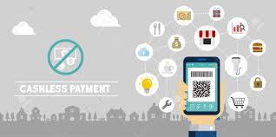
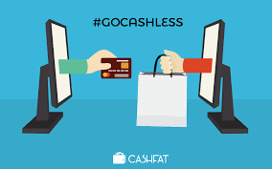
CASHLESS SIMPLY MEANS USING LESS CASH EVERYWHERE,
WHERE WE USE CASH, WHICH MIGHT BE :-
HOSPITALS
PUBLIC TRANSPORTS
TOLLS
SCHOOLS
PETROL STATIONS
KIRANA STORES

Slide 5
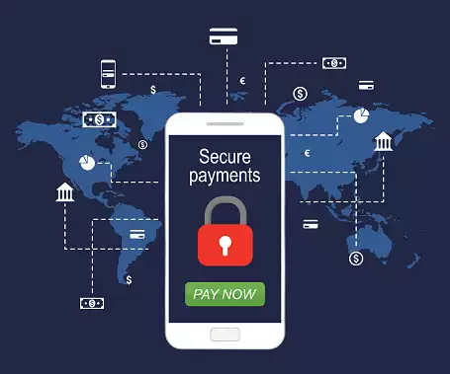
WHY CASHLESS ?
ADVANTEGES TO PEOPLE
Saves Money and Time.
Less Cash Decreased Crime.
Avoid Risk Of Carrying Cash.
Fake Currency Can Be Avoided.
Tracking Of Transactions Is Possible.

Slide 6
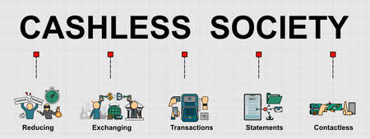
BENEFITS OF CASHLESS SOCIETY :-
COST REDUCTION
RISK REDUCTION
EFFICIENT AND CONVENIENT
TIME SAVING
TRACKING SPENDS
INCREASED TRANSPARENCY

Slide 7
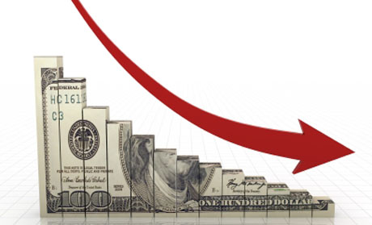
COST REDUCTION
Reducing cost of printing of cash.
Reducing cost of storing of cash.
Reducing cost of transportation of cash.

Slide 8
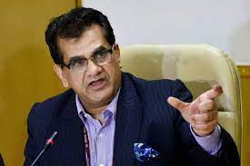
In an interview to Business Today's Dipak Mondal, NITI Aayog CEO Amitabh Kant said that the RBI and other commercial banks spend Rs 21,000 crore every year on currency management operations.
Niti Aayog CEO said, "The major objective is to increase the adoption and use of digital payments in India so that cash usage drops to 5-6 percent of GDP."

Slide 9
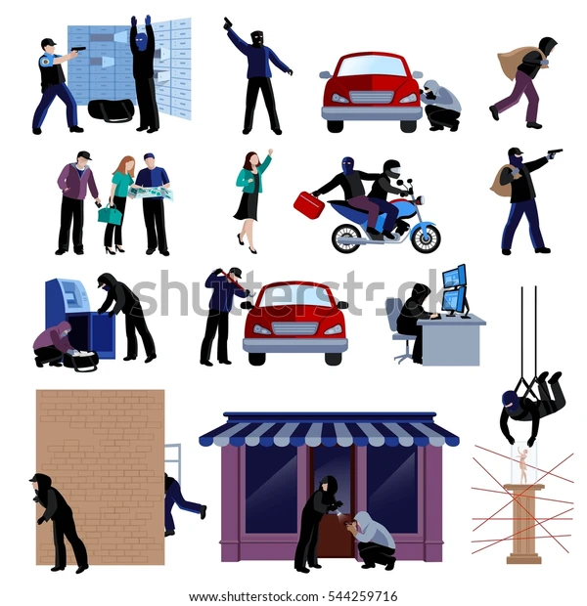
2) RISK REDUCTION
Their is no need to carry cash,
Because while carrying cash it is a risk of any kind of accident.

Slide 10
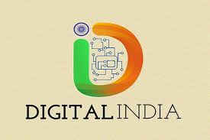
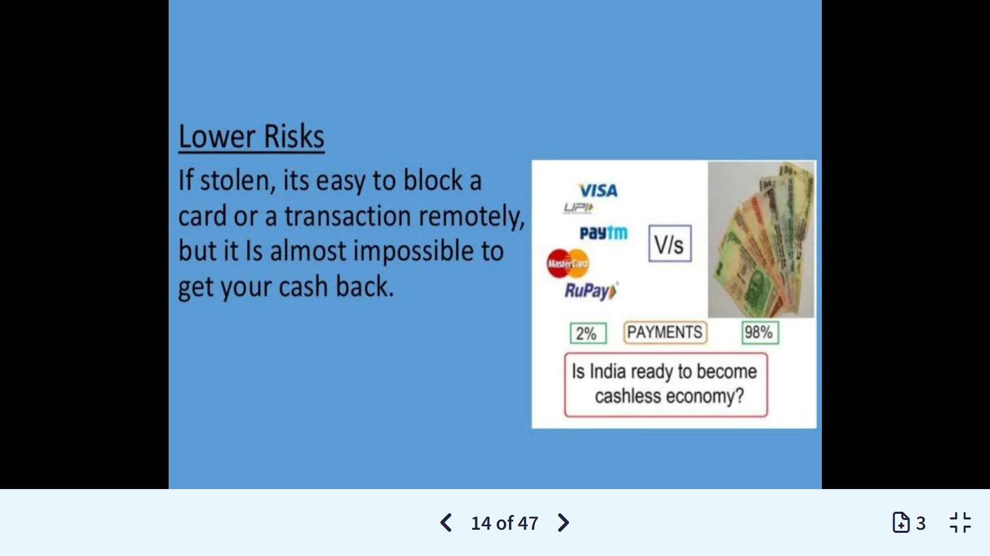
Lower Risks
If card or mobile is stolen, it’s easy to block a card or a transaction remotely, but it is almost impossible to get your cash back.

Slide 11
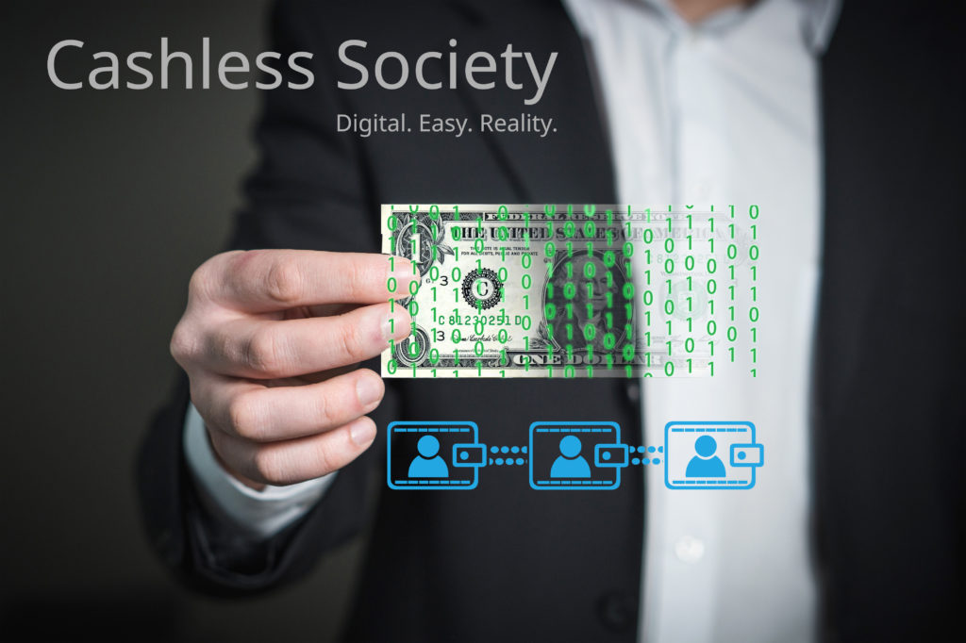
3) EFFICIENT AND CONVENIENT
People who are using online mode for payments, know that how easy is it to use.
People can pay their bills online and manage all the finances using their laptops and smartphones.

Slide 12
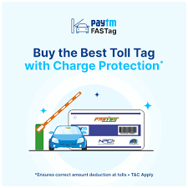
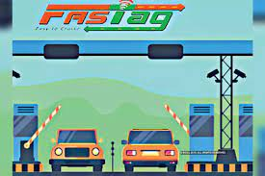
4) TIME SAVING
How FASTAG is a good initiative by GOVT. OF INDIA
To reduce vehicular traffic at the toll plazas, the Government of India (GOI) made a rule that pan India all vehicles traveling through toll plazas will have to mandatorily pay toll charges using FASTag. NHAI rolled out the program for Electronic Toll Collection on Toll Plazas on National Highways called FASTag.

Slide 13
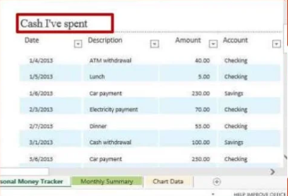
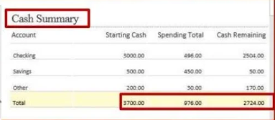
5) Tracking spends
Going cashless not only ease’s one’s life but also helps authenticate and formalize our transactions.

Slide 14
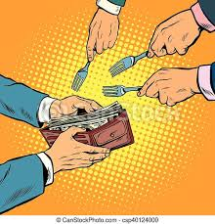

6) Increased Transparency
It helps in reducing corruption.
It helps in reducing Black money.

Slide 15
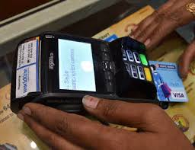

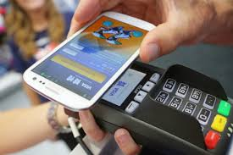
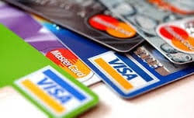
RECENT DIGITAL PAYMENTS MODES
✓ Banking cards (Debit/Credit Cards)
✓ Banks Prepaid cards
✓Internet banking
✓USSD
✓Mobile wallets
✓Mobile banking
✓Point of sale
✓Micro ATMs
✓AEPS
✓UPI

Slide 16
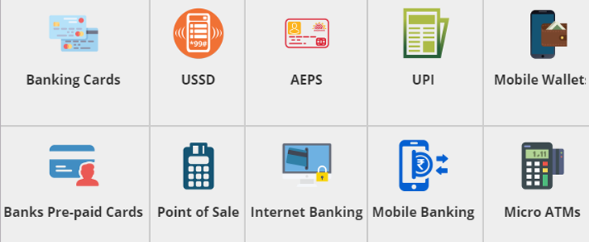
Mobile wallets is most helpful way of making cashless transactions as it is a convenient way of making payments anywhere anytime

Slide 17
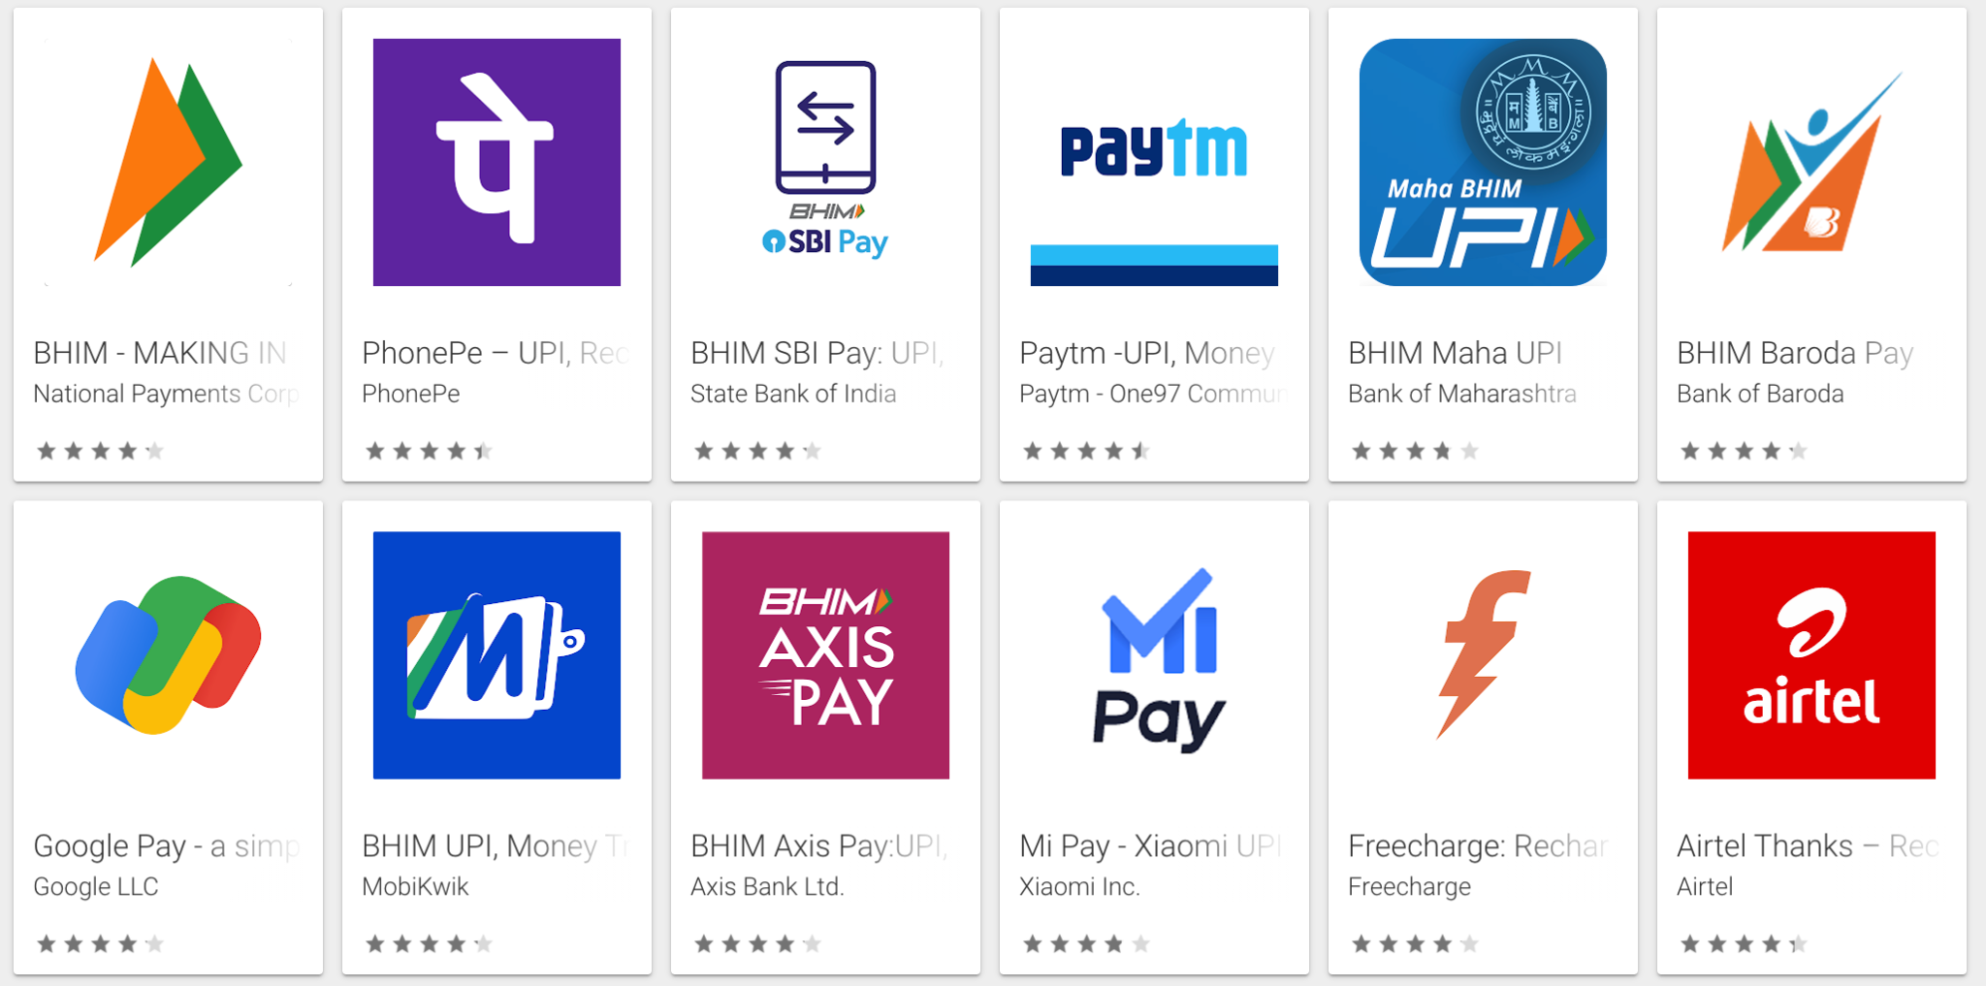

Slide 18
INDIA'S SCENARIO
India's reliance on cash
Indian economy is primarily to be driven by the use of cash and less than 5% of all payments happen electronically.
Indians traditionally prefer to spend and save in cash and a vast majority of the more-than 190 million population doesn't even have a bank account, making india world’s second largest country in terms of unbanked population after china…
A report by Google India and Boston Consulting Group showed that in 2019 around 75% of transactions in India were cash based while in developed countries like USA, Japan, France, Germany etc. it was just around 20-25%.
Inequalities between number of cards and card holders
ATM cards are mainly used in withdrawal purpose.

Slide 19
Changing trends
Cash is all set to lose currency in India, as an explosion in smartphone usage is driving a digital payments boom.
It was estimated that by 2020, nearly $500 billion worth of transactions in India will happen digitally via online wallets and other digital-payment systems which is 10 times the level in 2018, according to a report by Google India . And the estimation proved correct and india reached $547 billion worth of online transactions and approx $1 trillion in 2021-22. Further, the reports reveals that Indian consumers, are 90% as likely, to use digital payments for both online as well as offline transactions. Over 60% of digital payments value will be contributed by offline points of sale such as unorganized retail, eateries, transport etc.
Personal net banking has become more popular in India off late along with digital payment options that allow users to pay mobile phone, electricity and even taxi bills

Slide 20
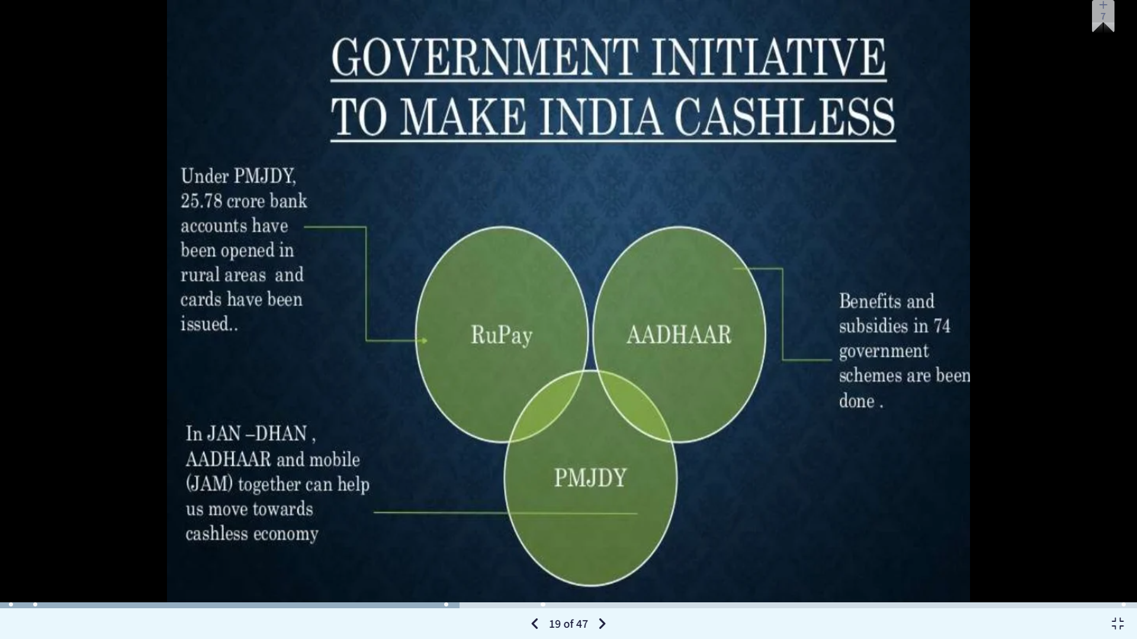




Slide 21
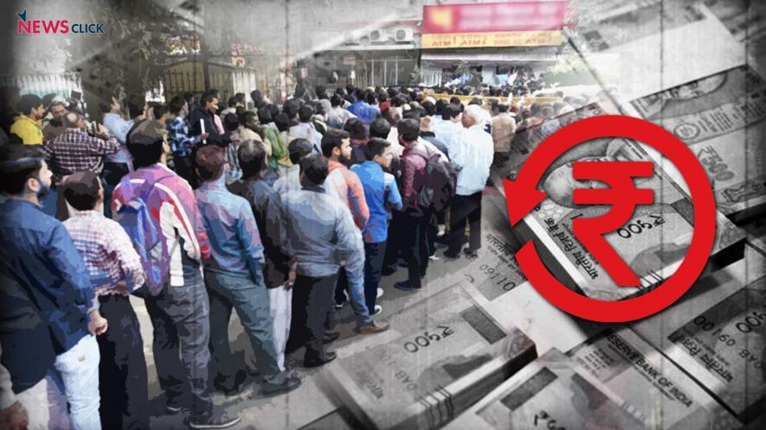

Slide 22
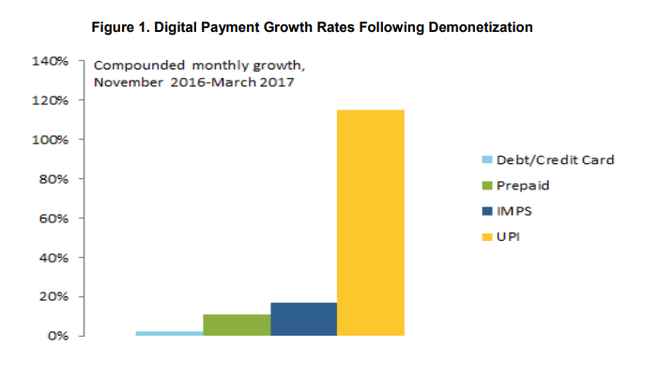
Before demonetization, cash was used for more than two-third of transactions in India.

Slide 23
ATM withdrawals recorded a 22% increase in April 2018 from the previous year, reaching 2.6 lakh crore. In comparison, cash withdrawals accounted for 2.2 lakh crore in the months leading to demonetisation.
Debit card usage is also up, showing that Indian consumers are comfortable with the flexibility of choosing whichever payment method best applies to their needs. In fact, debit card usage at point of-sale (POS) terminals grew by 24% compared to 2017. Contrary to cash however, debit card usage was very low - almost 50% less - prior to Modi's demonetisation policy.

Slide 24
THE QUESTION IS STILL HERE
CASHLESS INDIA : DREAM OR REALITY ???
While India is trying to take step towards digital, it has a long way to go. Sweden, South Korea, Denmark, Canada have high percentage of cashless transactions as high as 75-85%. Norway has stopped cheques. Of course, these countries are either smaller, or have a more educated population, higher penetration of organized retail and higher awareness about digital than India The problem may also be that more often than not users are being pushed to pay digitally and not the merchant to accept digital payments. You can't just say go for digital and not educate villagers, the smallest of kirana store owners or cloth merchants to adopt cashless payments. points to lack of habit and trust, security and safety standards along with the absence of a fast, reliable dispute resolution system that ensures people don't abandon cash totally.

Slide 25
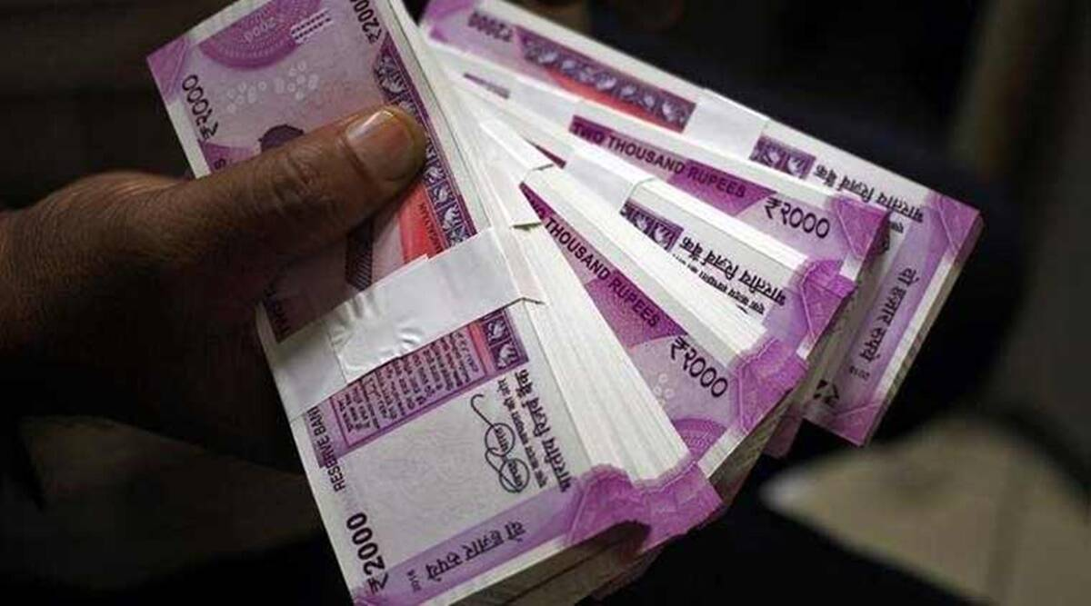
98% of all consumer payments in India use cash.
About 98 % of all consumer payments in India use cash, and the high frequency of handling forces the monetary authority to withdraw about 75 % of its notes in circulation in a typical year - more than the number of bank notes collectively produced by all countries taken together with the exception of China.
-Economic Times

Slide 26
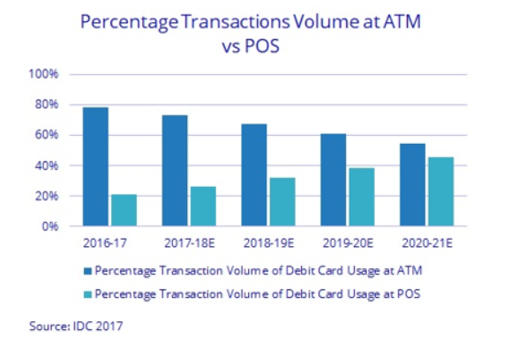
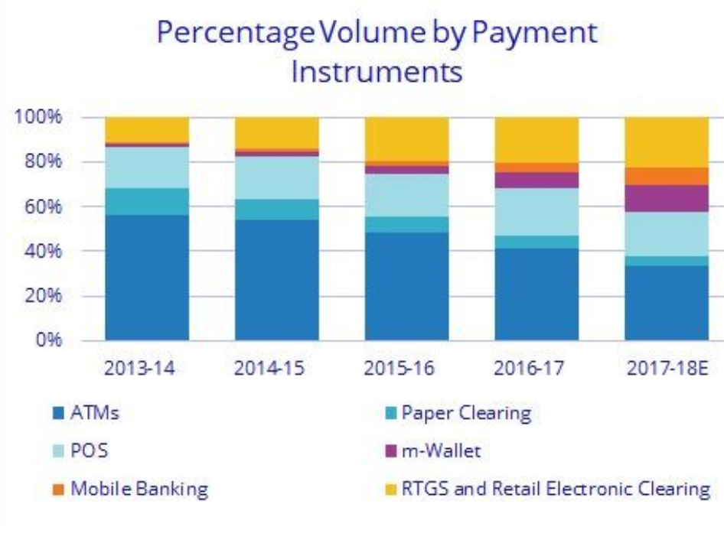

Slide 27
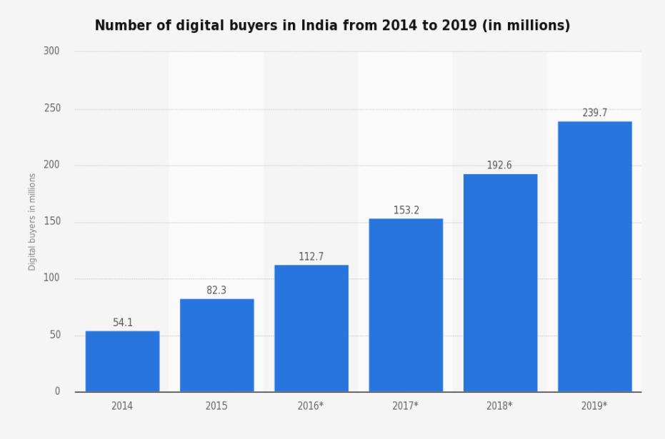

Slide 28
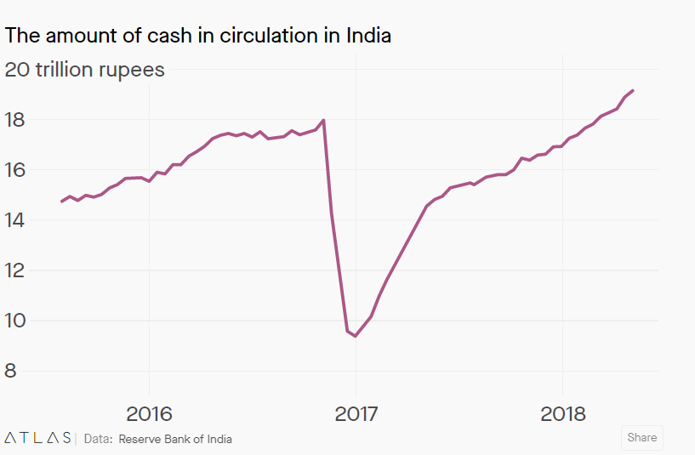
According to money supply reports from the RBI, in the first four months of 2018, the amount of cash in circulation rose by more than Rs. 2 trillion, i.e. from about Rs.17 trillion to over Rs.19 trillion-a nearly 40% annualized growth rate.
That is far faster growth than before demonetisation and much faster than growth of nominal GDP, which is expected to rise by 10-12% in the 2018-2019 fiscal year.

Slide 29
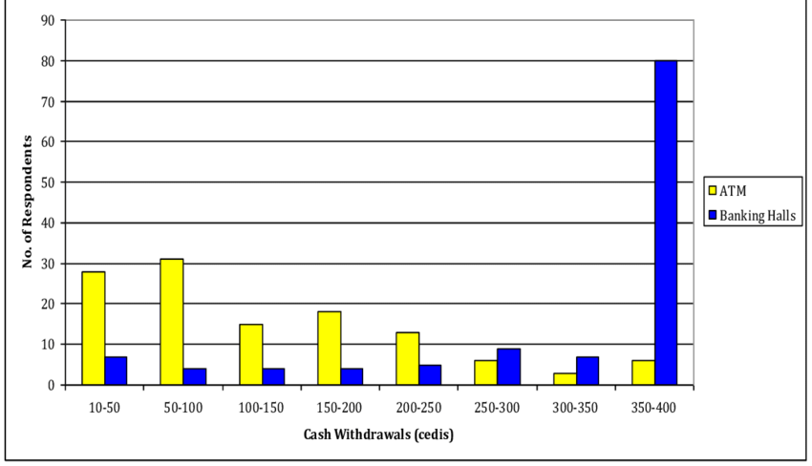
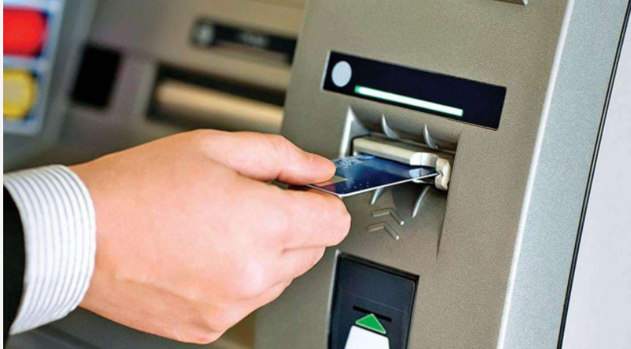
ATM withdrawals recorded a 22% increase in April 2018 from the previous year, reaching 2.6 lakh crore. In comparison, cash withdrawals accounted for 2.2 lakh crore in the months leading to demonetisation.
Debit card usage is also up, showing that Indian consumers are comfortable with the flexibility of choosing whichever payment method best applies to their needs. In fact, debit card usage at point of-sale (POS) terminals grew by 24% compared to 2017. Contrary to cash however, debit card usage was very low - almost 50% less - prior to Modi's demonetisation policy.

Slide 30
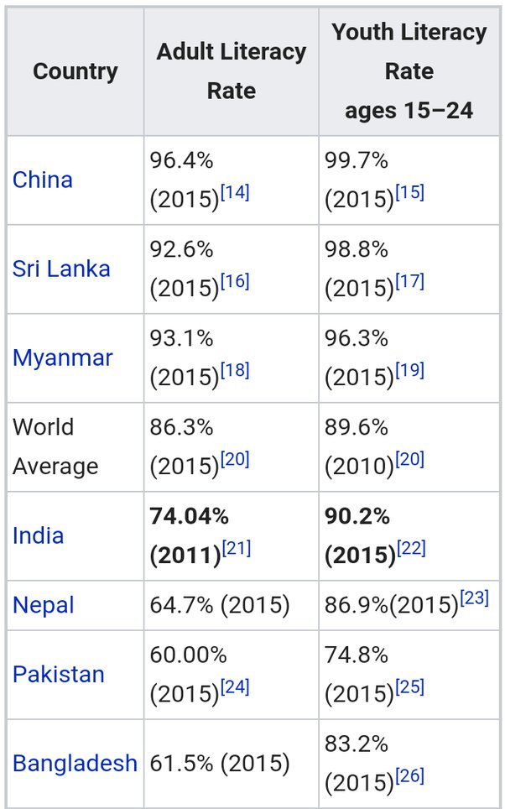


Slide 31
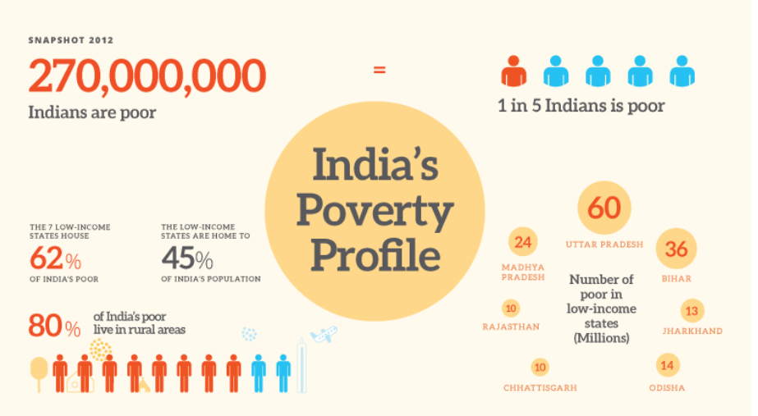

Slide 32
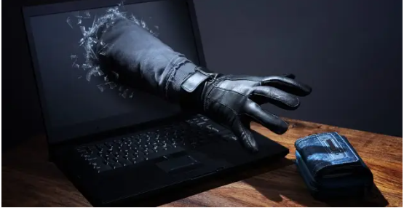
CYBER SECURITY
MAJOR CHALLENGES :
Exponential growth in data
Storage of skilled cyber security
Lack of infrastructure

Slide 33
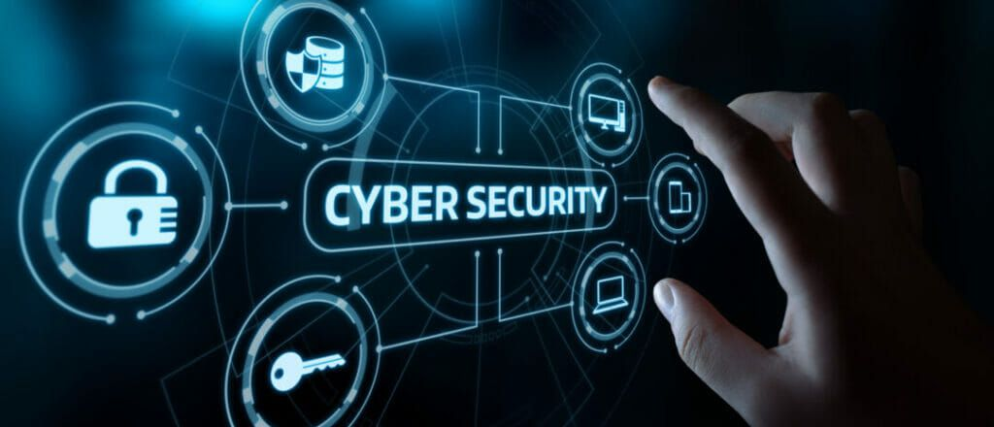
CYBER SECURITY :
NO STRICT LAW AND ORDER.
IT LAWS WERE MADE 18 YEARS AGO.
INFORMATION TECHNOLOGY ACT,2000.
NO SUCH MAJOR CHANGES HAD DONE IN IT .

Slide 34

ONLINE BANKING FRAUD
SIM SWAP FRAUD ??
SIM SWAP
UNDER SIM SWAP, fraudsters manage to get a new SIM card issued against your registered mobile number through the mobile service provider. With the help of this new SIM card, they get One Time Password (OTP) and alerts, required for making financial transaction through your bank account.

Slide 35
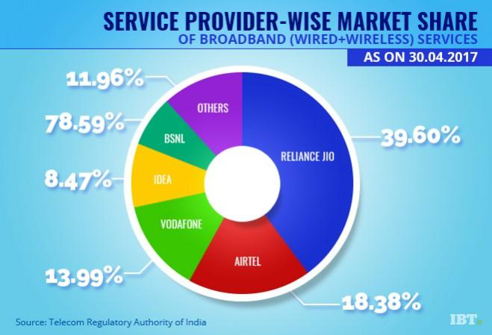
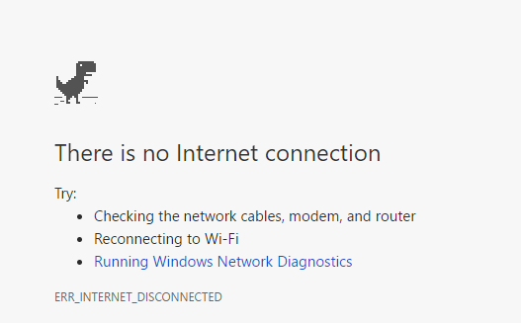
INTERNET CONNECTIVITY
462 MILLIONS INTERNET USER IN INDIA AS OF JAN 2020

Slide 36
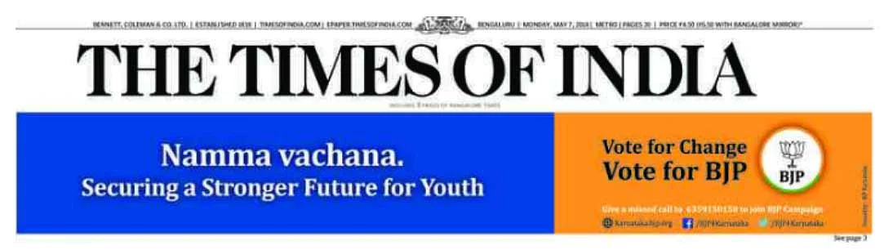
INTERNET CONNECTIVITY
AVERAGE PAGE ON MOBILE 5.5 SECONDS,CHINA 2.6 SECONDS
The average time to load a mobile phone is 5.5 seconds in india, compared to 2.6 seconds in china,4.5 in sri lanka,4.9 in bangladesh and 5.8 in pakistan,according to the ”state of the internet 2019” report by akamai technologies, a global content delivery network services provider. Israel has the fastest load time at 1.3 seconds.
Mobile Internet speeds will make users less likely to use their phones for banking transactions,with oracle maxymiser, a website optimisation tool by oracle, a US multinational, reporting a two-second threshold before users stop an online transaction — although 68 percent of responding reported they would not wait six seconds for pages or images to load on a bank’s website or mobile site

Slide 37
INTERNET CONNECTIVITY
INTERNET BLACKOUT
INTERNET SUSPENSION ON INDEPENDENCE DAY IS THE NORM
Suspension of mobile and internet services in the state on independence day is a norm.
In 2019,mobile and internet services of all cellular companies,including the state-run BSNL,were suspended in kashmir valley,including in the summer capital of srinagar.
NUMBER OF INTERNET BANS IN INDIA IN 2019 HIGHEST IN THE WORLD,YET AGAIN
There was no need of an internet ban in sikar,but the local government said it was for ‘public safety’

Slide 38
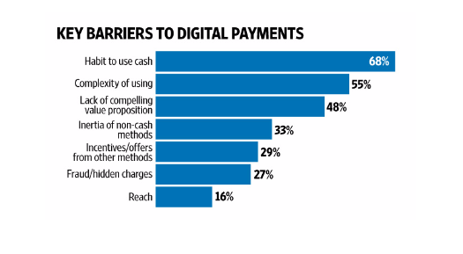
SOME MORE REASONS, WHY INDIA CAN’T GO CASHLESS :-
1) Large number of population do not have bank account.
2) Lack of POS Machines.
3) Merchants prefer cash to avoid taxes.
4) People are not modernized enough to use smartphones and internet.

Slide 39
CONCLUSION
As we know, India is a developing country and we are facing many problems regarding Internet connectivity and we don’t have a good cyber security department in our country, and crime in India has been increasing day by day, criminals make advantage of online methods or cyber attack like online banking frauds, KYC frauds etc.
So, India is not ready for cashless economy completely as from survey only 24% of Indians uses smartphone , also many people aren’t registered in banks and thus are unaware of online mode , therefore we as a country need to focus on every aspect as we mentioned above before going cashless……

Slide 40
REFERENCES
India’s Readiness for Digital Economy: Cashless Economy(by Ajit Roy)
https://en.wikipedia.org/wiki/Cashless_society (Wikipedia)
https://timesofindia.indiatimes.com/blogs/voices/the-possibility-of-a-cashless-society-speeds-up-in-india/ (Article).

Slide 41


